Slide 1

Welcome
Design Principles
Notes:
Mandatory
ACTION: Adjust title to fit your course.

Slide 2
User-centered design

Slide 3
User-Centered Design
An approach to designing products, systems, and services that places the needs, preferences, and behaviors of the users at the forefront of the design process.
The goal of user-centered design is to create products that are effective, efficient, and satisfying for the users, ultimately leading to better usability and user experience.

Slide 4
User-Centered Design - key principles
User Involvement: Users are actively involved throughout the design and development process. Their input, feedback, and insights are integral to making design decisions.
Iterative Process: UCD is an iterative process, with frequent cycles of design, testing, and refinement. This allows for continuous improvement based on user feedback.
Focus on User Needs: Design decisions are driven by a deep understanding of user needs, goals, and tasks. Research methods like surveys, interviews, and observations are used to gather this information.

Slide 5
discussion
🎤
What is "Software Design"?

Slide 6
Change in Software
Change is inevitable in software.
It evolves continuously to meet the ever increasing demands of its users.
At the same time, the intangible nature of software makes it difficult to manage this continuous change.
What typically results is poor software quality and huge technical debt.

Slide 7
Design Principles
Best practices or suggested practices to increase code quality.
There are easy and hard ones.
Programming language and frameworks can help you.
No rule without exception.
Experience comes with time.

Slide 8
Coupling & Cohesion
These metrics describe how easy it will be to change the behavior of some code.
Elements are coupled if a change in one forces a change in another. For e.g., if two classes inherit from a common parent, then a change in one class might require a change in the other.
Think of a combo audio system: It’s tightly coupled because if we want to change from analog to digital radio, we must rebuild the whole system. If we assemble a system from independent components, it would have low coupling and we could just swap out the receiver. “Loosely” coupled features are easier to maintain.
An element’s cohesion is a measure of whether its responsibilities form a meaningful unit. For e.g., a class that parses both dates and URLs is not coherent, because they’re unrelated concepts.

Slide 9
Coherent
Not Coherent
Not Coherent
Parser
URLPunctuationParser
parseURL(URL url)
parseDate(Date date)
parse(URL url)
parseText(String text)
URLParser
Represents a whole concept. Includes the complete URL parsing features like host, protocol, resource, etc.
parse(URL url)
DateParser
parse(Date date)

Slide 10
SOLID
The SOLID principles were introduced by Robert C. Martin in his 2000 paper “Design Principles and Design Patterns.” These concepts were later built upon by Michael Feathers, who introduced us to the SOLID acronym. And in the last 20 years, these five principles have revolutionized the world of object-oriented programming, changing the way that we write software.
Notes:
https://fi.ort.edu.uy/innovaportal/file/2032/1/design_principles.pdf

Slide 11
Why SOLID?
Design principles encourage us to create more maintainable, understandable, and flexible software. Consequently, as our applications grow in size, we can reduce their complexity and save ourselves a lot of headaches further down the road!
Notes:
https://fi.ort.edu.uy/innovaportal/file/2032/1/design_principles.pdf

Slide 12
Single Responsibility Principle
Based on the principle of cohesion, as described by Tom DeMarco in his book Structured Analysis and System Specification (1979), and Meilir Page-Jones in The Practical Guide to Structured Systems Design (1988).
“A class should have one and only one reason to change”
Notes:
The more responsibilities your class has, the more often you need to change it.

Slide 13
Open-Closed Principle
Bertrand Meyer coined the open-closed principle in 1988. It means simply we should write our modules so that they can be extended, without requiring them to be modified. In other words, we want to be able to change what the modules do, without changing the source code of the modules.
“Open for extension and closed for modification”
Notes:
Example: Real life analogy: Smartphones
We have core functionality in the OS, such as telephoning, SMS and data transfer,
Apps can enhance and provide more functionality without changing the core functionality

Slide 14
OCP violation in example code
public class Alarm
{
// …
private Sensor sensor = new Sensor();
Want to use new type of sensor?
Must modify code; cannot extend it

Slide 15
Liskov Substitution Principle
Introduced by Barbara Liskov in a 1987 conference keynote address titled Data abstraction and hierarchy
Subclasses should substitute the parent class
Any child type of a parent type should be able to stand in for that parent without things blowing up
“Derived classes should be substitutable for their base classes”

Slide 16
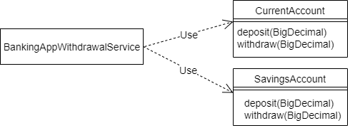
Banking application
Our banking application supports two account types – “current” and “savings”. These are represented by the classes CurrentAccount and SavingsAccount respectively.
Notes:
Unfortunately, there is a problem with extending this design. The BankingAppWithdrawalService is aware of the two concrete implementations of account. Therefore, the BankingAppWithdrawalService would need to be changed every time a new account type is introduced.

Slide 17
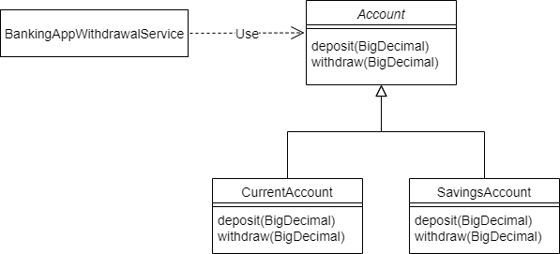
Liskov Substitution Principle
Using the Open/Closed Principle to Make the Code Extensible

Slide 18
A new account type
public class FixedDepositAccount extends Account {
@Override
protected void deposit(BigDecimal amount) {
// Deposit into this account
}
@Override
protected void withdraw(BigDecimal amount) {
throw new UnsupportedOperationException("Withdrawals are not supported by FixedDepositAccount!!");
}
}
public class FixedDepositAccount extends Account {
// Overridden methods…
}
Notes:
This will make the Banking application to crash, in case someone tries to use the withdraw method. This shows there is clearly something wrong with this design if a valid combination of objects results in an error.

Slide 19
What went wrong ?
The WithdrawalService is a client of the Account class. It expects that both Account and its subtypes guarantee the behavior that the Account class has specified for its withdraw method
However, by not supporting the withdraw method, the FixedDepositAccount violates this method specification. Therefore, we cannot reliably substitute FixedDepositAccount for Account.
In other words, the FixedDepositAccount has violated the Liskov Substitution Principle

Slide 20
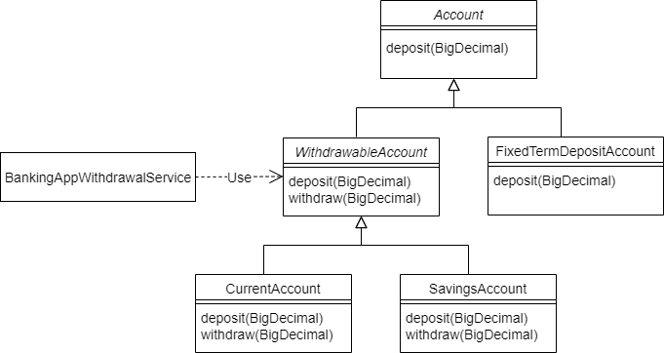
Revised class diagram
Notes:
Because all accounts do not support withdrawals, we moved the withdraw method from the Account class to a new abstract subclass WithdrawableAccount. Both CurrentAccount and SavingsAccount allow withdrawals. So they've now been made subclasses of the new WithdrawableAccount.

Slide 21
Refactored BankingAppWithdrawalService
public class BankingAppWithdrawalService {
private WithdrawableAccount withdrawableAccount;
public BankingAppWithdrawalService(WithdrawableAccount withdrawableAccount) {
this.withdrawableAccount = withdrawableAccount;
}
public void withdraw(BigDecimal amount) {
withdrawableAccount.withdraw(amount);
}
}
Notes:
This means BankingAppWithdrawalService can trust the right type of account to provide the withdraw function.

Slide 22
Interface Segregation Principle
Robert C Martin while consulting for Xerox
Make fine grained interfaces that are client specific
The goal of this principle is to reduce the side effects of using larger interfaces by breaking application interfaces into smaller ones. It's similar to the Single Responsibility Principle, where each class or interface serves a single purpose.
“Clients should not be forced to depend upon interfaces that they do not use”

Slide 23
Example
public interface Payment {
void initiatePayments();
Object status();
List<Object> getPayments();
}
Notes:
Let's look into a situation where we've got a Payment interface used by an implementation BankPayment:

Slide 24
Example
public class BankPayment implements Payment {
@Override
public void initiatePayments() {
// ...
}
@Override
public Object status() {
// ...
}
@Override
public List<Object> getPayments() {
// ...
}
}
Notes:
And the implementation:

Slide 25
Polluting the interface
Now, as we move ahead in time, and more features come in, there's a need to add a LoanPayment service. This service is also a kind of Payment but has a few more operations.
public interface Payment {
// original methods
...
void intiateLoanSettlement();
void initiateRePayment();
}

Slide 26
LoanPayment implementation
public class LoanPayment implements Payment {
@Override
public void initiatePayments() {
throw new UnsupportedOperationException("This is not a bank payment");
}
@Override
public Object status() { // ... }
@Override
public List<Object> getPayments() {// ... }
@Override
public void intiateLoanSettlement() { // ...}
@Override
public void initiateRePayment() {// ...}
}
Implementing unwanted functions could lead to many side effects. Here, the LoanPayment implementation class has to implement the initiatePayments() without any actual need for this.
Notes:
Now, since the Payment interface has changed and more methods were added, all the implementing classes now have to implement the new methods.

Slide 27
public class BankPayment implements Payment {
@Override
public void initiatePayments() { // ...}
@Override
public Object status() { // ... }
@Override
public List<Object> getPayments() { // ...}
@Override
public void intiateLoanSettlement() {
throw new UnsupportedOperationException("This is not a loan payment");
}
@Override
public void initiateRePayment() {
throw new UnsupportedOperationException("This is not a loan payment");
}
}
Implementing unwanted functions could lead to many side effects. Here, the BankPayment implementation class has to implement the initiateLoanSettlement() without any actual need for this.
Notes:
what happens to our BankPayment class:
BankPayment implementation now has implemented the new methods. And since it does not need them and has no logic for them, it's just throwing an UnsupportedOperationException. This is where we start violating the principle.

Slide 28
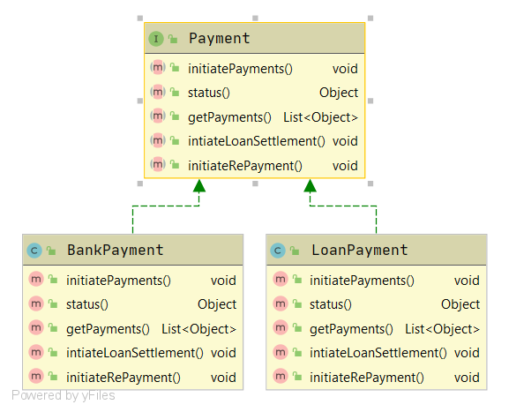
Applying the principle
Notes:
Notice in the class diagram, and referring to the interfaces in the earlier section, that the status() and getPayments() methods are required in both the implementations. On the other hand, initiatePayments() is only required in BankPayment, and the initiateLoanSettlement() and initiateRePayment() methods are only for the LoanPayment.
With that sorted, let's break up the interfaces and apply the Interface Segregation Principle. Thus, we now have a common interface:

Slide 29
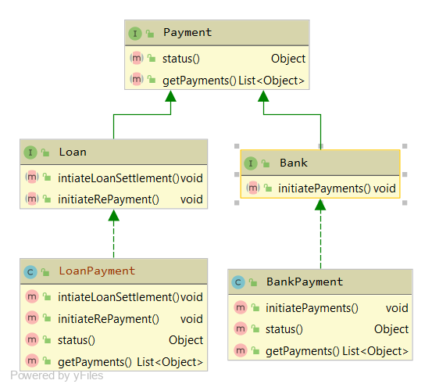
Applying the principle
Notes:
As we can see, the interfaces don't violate the principle. The implementations don't have to provide empty methods. This keeps the code clean and reduces the chance of bugs.

Slide 30
Dependency Inversion Principle
The dependency inversion principle was postulated by Robert C. Martin
High-level modules should not depend on low-level modules. Both should depend on abstractions.
Abstractions should not depend on details. Details should depend on abstractions.
“Depend on abstractions, not on concretions.”

Slide 31
DIP violation in example code
High Level Class
public class Alarm
{
// …
private Sensor sensor = new Sensor();
Dependency
Low Level Class

Slide 32

Recommended Mandatory reading

Slide 33
Design Patterns

Slide 34
Design patterns
Design patterns are reusable solutions to common problems that arise during software design and development.
They are general, proven solutions that provide a blueprint for solving specific design and architectural challenges in a consistent and effective way.
Design patterns help developers create more maintainable, modular, and scalable software by providing well-defined templates for structuring code and interactions between components.
Design patterns can be categorized into three main types.

Slide 35
Creational patterns
These patterns deal with object creation mechanisms, trying to create objects in a manner suitable to the situation. Common creational patterns include:
Singleton: Ensures a class has only one instance and provides a global point of access to it.
Factory Method: Defines an interface for creating objects but allows subclasses to alter the type of objects that will be created.
Abstract Factory: Provides an interface for creating families of related or dependent objects without specifying their concrete classes.
Builder: Separates the construction of a complex object from its representation, allowing the same construction process to create various representations.

Slide 36
Keep It Simple, Stupid (KISS)

Slide 37
Keep It Simple, Stupid (KISS)
The KISS principle, which stands for "Keep It Simple, Stupid," is a design principle that emphasizes simplicity and clarity in various fields, including software development, design, engineering, and management.
The principle suggests that simplicity should be a key goal and that unnecessary complexity should be avoided.

Slide 38
System Architecture

Slide 39
System architecture
System architecture refers to the high-level structure and organization of a complex software or hardware system.
It encompasses the design, layout, components, interactions, and relationships between various parts of a system to achieve specific goals and functionalities.
System architecture serves as a blueprint that guides the development, implementation, and maintenance of the system.

Slide 40




Thank you!

